Slide 1

Face Recognition based Gate
Pass System for UEMJ Main Gate
By
ALOK AGARWAL
(B.Tech 2nd Year, Enrollment No.:
12022002001042)
SHASHANK KUMAR SINGH
(B.Tech 2nd Year, Enrollment No.:
12022002001045 )
Under the Supervision of
DR. G. UMA DEVI
Dept. of Computer Science & Engineering
University of Engineering & Management, Jaipur

Slide 2
Outlines
Introduction
Objectives
Result Example
Result Analysis
Limitations
Conclusion & Future Scope
References
Acknowledgement

Slide 3
Introduction
UEMJ Main Gate Challenges: Manual entry system struggles with growing campus population, leading to congestion and delays.
Project Objective: Implement face recognition technology to enhance efficiency, security, and accuracy.
Key Objectives:
Efficiency: Streamline entry process to reduce waiting times.
Security: Strengthen authentication to prevent unauthorized access.
Accuracy: Ensure reliable logging and monitoring of access data.
Automation: Introduce automation for improved operational efficiency.
Project Impact: Transform gate pass management at UEMJ Main Gate, creating a safer and technologically advanced campus environment.

Slide 4
Objectives
Problem Statement: UEMJ Main Gate faces challenges in managing access control efficiently and securely with traditional gate pass systems.
Proposed Solution: Develop a Face Recognition-based Gate Pass System using modern technologies to revolutionize access control management.
Objective Goals: Implement intuitive user interface, robust face detection algorithms, advanced face recognition capabilities, and provide comprehensive feedback for enhanced transparency.
Expected Outcomes: Overcome limitations of traditional systems, enhance security measures, reduce operational overheads, and improve overall efficiency for a safe and seamless access experience.

Slide 5
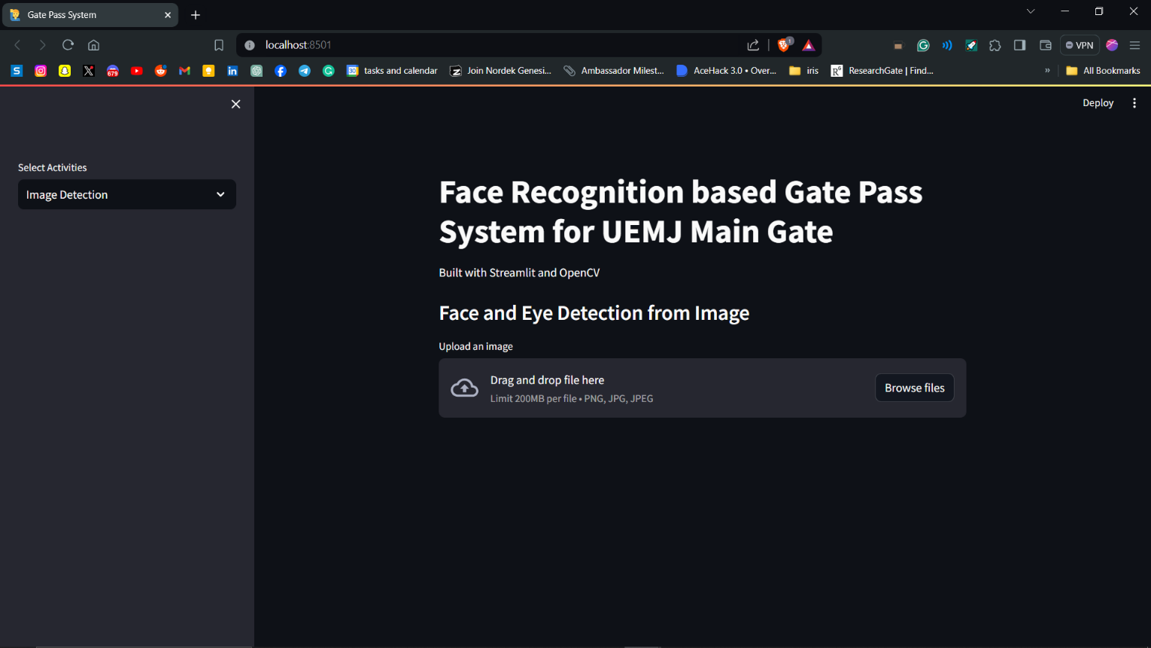
Result: Example

Slide 6
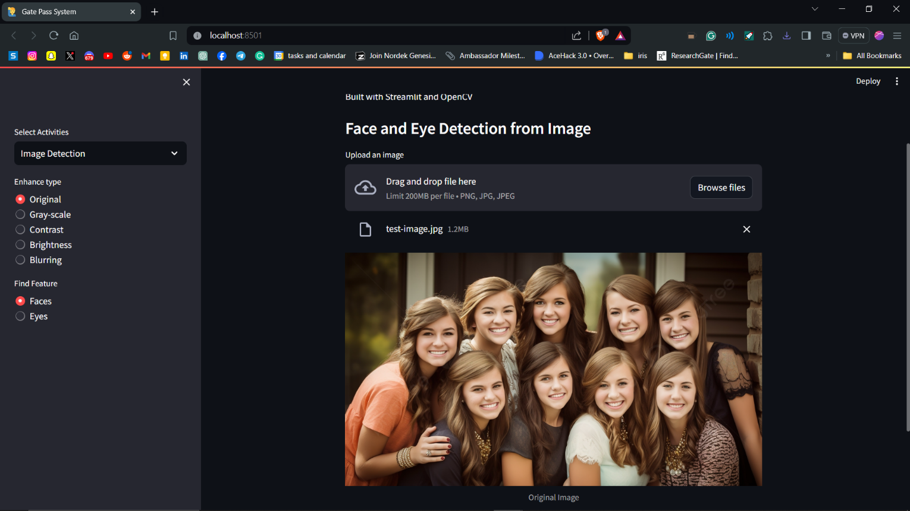
Result Analysis

Slide 7
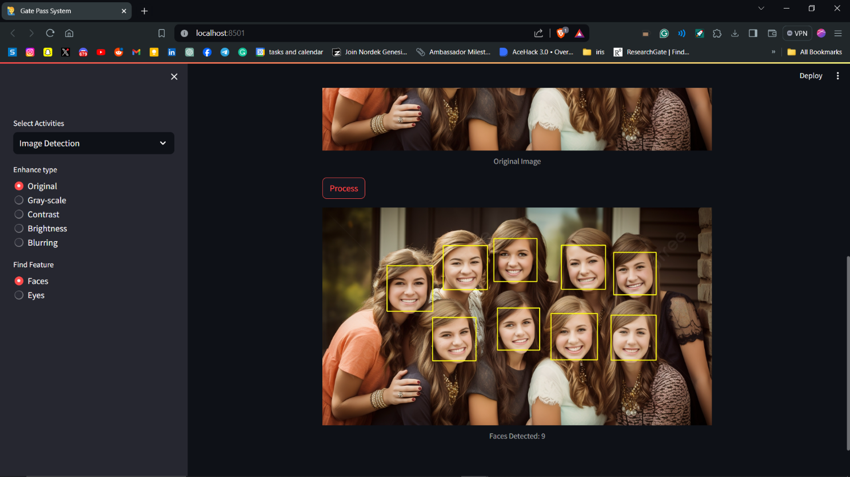
Result Analysis

Slide 8
Limitation
Manual Verification Processes: Current gate pass systems rely on manual verification processes, leading to inefficiencies and delays during peak hours.
Susceptibility to Errors: Handwritten logs are prone to human errors, resulting in discrepancies and inaccuracies in entry and exit records.
Lack of Real-Time Feedback: Traditional systems lack the ability to provide real-time feedback, hindering effective monitoring and management of access control.
Security Concerns: Ensuring the authenticity of gate passes and preventing unauthorized access remains a significant concern with existing systems.

Slide 9
Conclusions & Future Scope
Future Expansion: Our Face Recognition-based Gate Pass System aims to evolve into a seamless solution where users can simply approach the webcam for automatic detection and recording of exit entries, minimizing manual efforts and streamlining the process.
Automated Data Entry: We envision incorporating preloaded data such as student names, enrollment numbers, and other relevant information to expedite gate pass issuance and management, enhancing user convenience and reducing administrative burden.
Advanced Features Integration: Future developments include real-time monitoring, alerts for suspicious activities, and integration with mobile applications for remote gate pass requests and notifications, catering to modern user needs and enhancing overall campus security.
Continuous Improvement: Our system's future scope encompasses integration with biometric data, multi-factor authentication, scalability, compliance with data privacy regulations, and iterative refinement based on user feedback, ensuring ongoing enhancement and alignment with evolving requirements.

Slide 10
References
Dr. Sunil Bhutada, Dr. Sreenivas Mekala, Mayukhi Gandham, Rishika Bhat, Ruchitha Upadhyayula, "Face Recognition Based Gate Pass System", International Journal of Scientific Research in Science, Engineering and Technology (IJSRSET), Online ISSN : 2394-4099, Print ISSN : 2395-1990, Volume 9 Issue 3, pp. 391-397, May-June 2022. Journal URL : https://ijsrset.com/IJSRSET2293164
An Introduction to Face Recognition Technology Shang-Hung Lin, Ph.D. IC Media Corporation shanghung.lin@ic-media.com
Face Recognition: From Theory to Applications edited by Harry Wechsler, Jonathon P. Phillips, Vicki Bruce, Francoise Fogelman Soulie, Thomas S. Huang
Face Recognition - edited by Miloš Oravec
Face recognition system security analysis for authentication
https://medium.com/@divijagodse/face-recognition-system-security-analysis-for-authentication-86866066533d
What is Facial Recognition Technology and How Does it Work?
https://medium.com/@mygreatlearning/what-is-facial-recognition-technology-and-how-does-it-work-9fdefd335c3b
The Python Standard Library
https://docs.python.org/3/library/index.html

Slide 11
Acknowledgement
The endless thanks go to Lord Almighty for all the blessings he has showered on one, which has enabled me to write this last note in my research work. During the period of my research, as in the rest of my life, We have been blessed by Almighty with some extraordinary people who have spun a web of support around me. Words can never be enough to express how grateful we are to those incredible people who made this thesis possible. We would like an attempt to thank them for making my time during my research in the Institute a period we will treasure. We are deeply indebted to my research supervisor, Dr G. Uma Devi me such an interesting thesis topic. Each meeting with him added valuable aspects to the implementation and broadened my perspective. She has guided me with his invaluable suggestions, lightened up the way in my darkest times and encouraged me a lot in academic life
Alok Agarwal
Shashank Kumar Singh

Slide 12

Dept. of CSE, University of Engineering & Management Jaipur

